Slide 1



UI UX User Interface User Experience
NIDHILA K V

Slide 2
INTRODUCTION
UX design focuses on creating a seamless and meaningful user experience by understanding user needs,conducting0 research , and designing interfaces
UI design focuses on the visual , interactive elements of a product

Slide 3
What is User Experience(UX) Design?
User experience design is about understanding customer’s feelings when interacting with a website, app, or product. A good UX design is functional , desirable, credible, findable, usable, and valuable.
User experience does not depend only on how the product is designed. there are other aspects as well that make UX design more challenging
UX designer Peter Morville expresses these critical tenets as a user experience honey comb

Slide 4
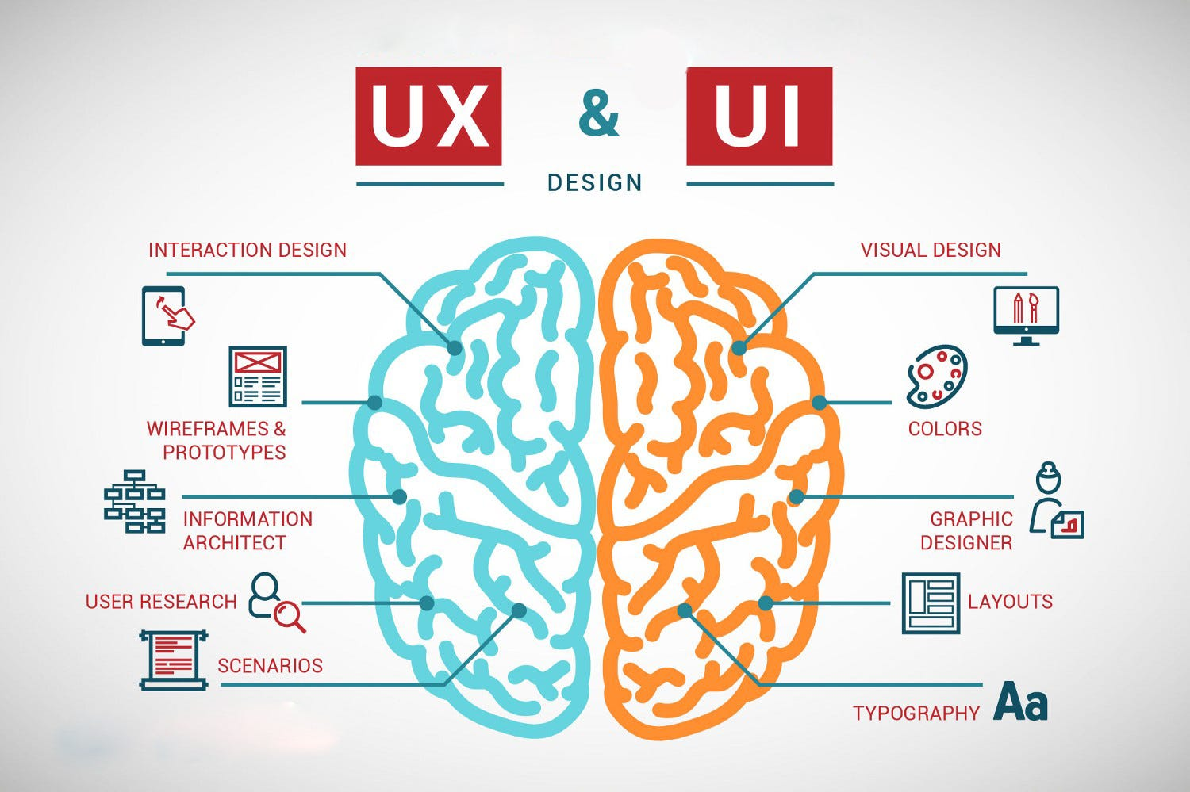

Slide 5
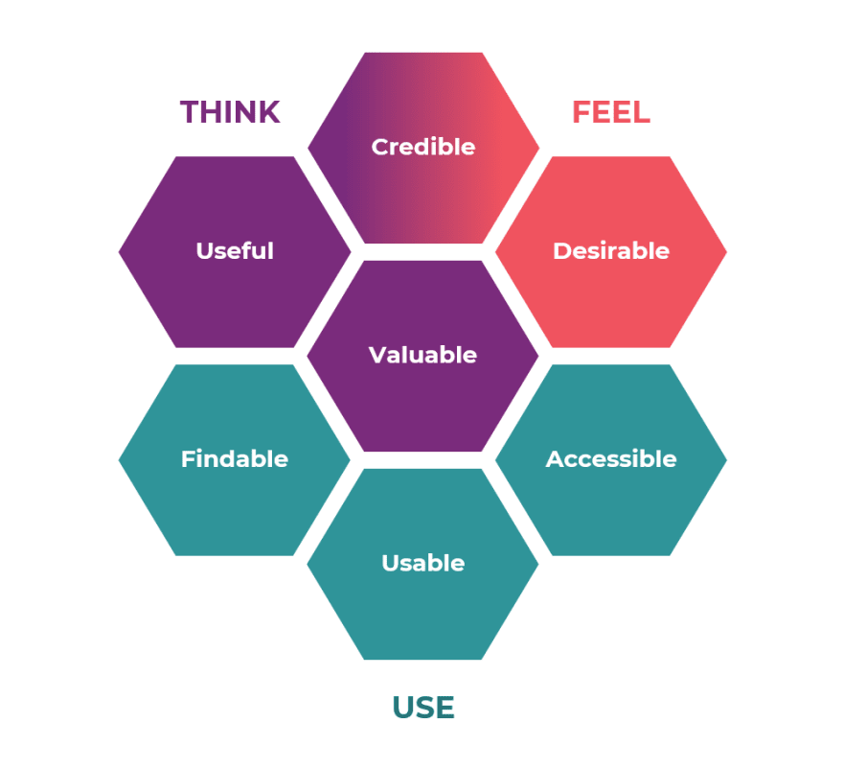
HONEY COMB

Slide 6
Useful: Fulfills a user’s needs.
Usable: Easy to use and understand.
Desirable: Visually attractive
Findable: easy to navigate and find information.
Accessible: Users with disabilities can use the product.
Credible: The product, company, and services are trustworthy.
Valuable: Delivers business value.

Slide 7
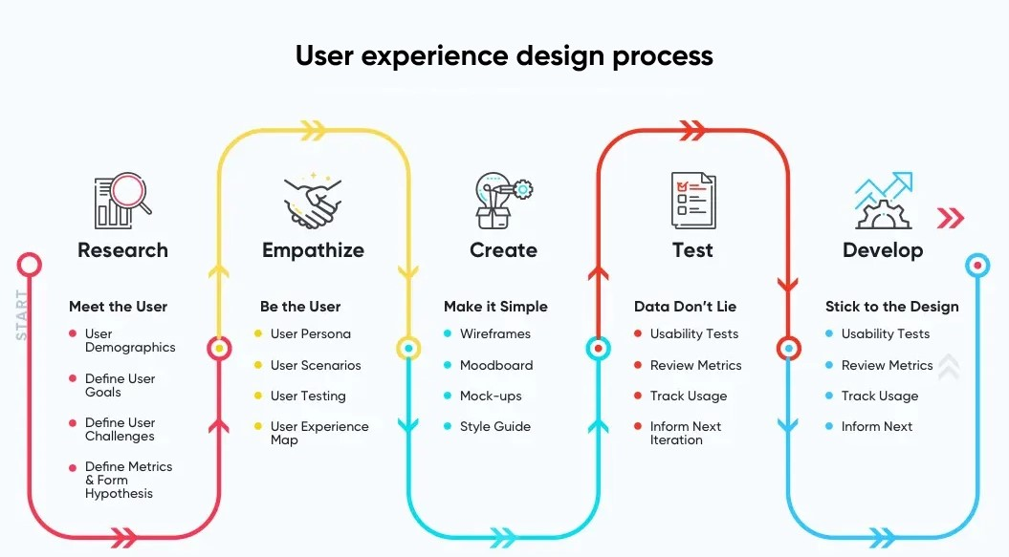

Slide 8
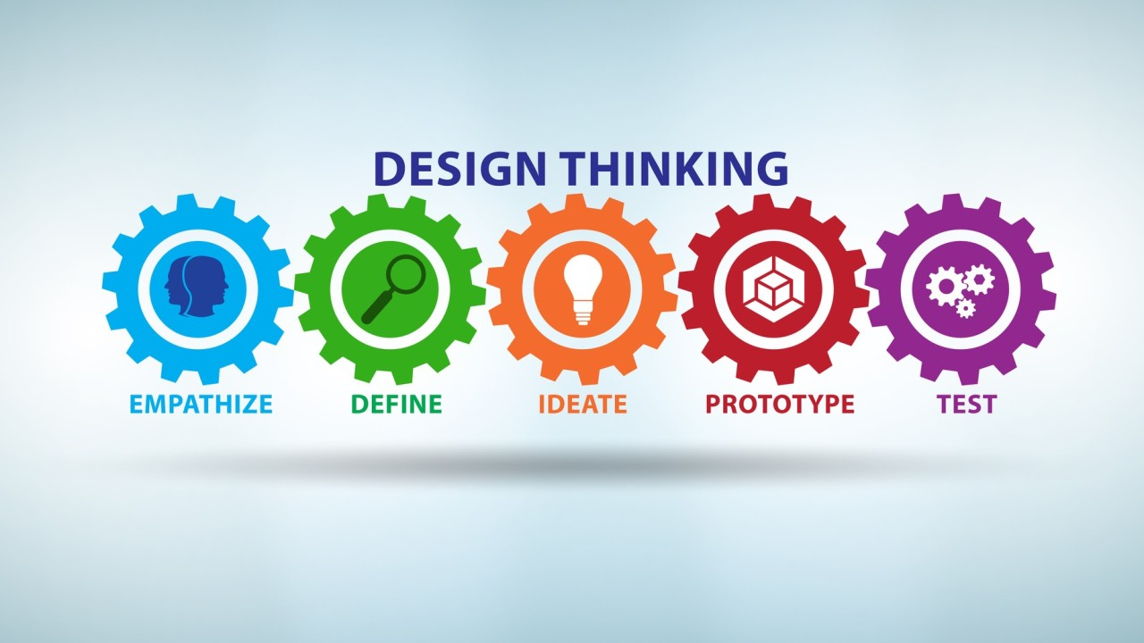
DESIGN THINKING

Slide 9
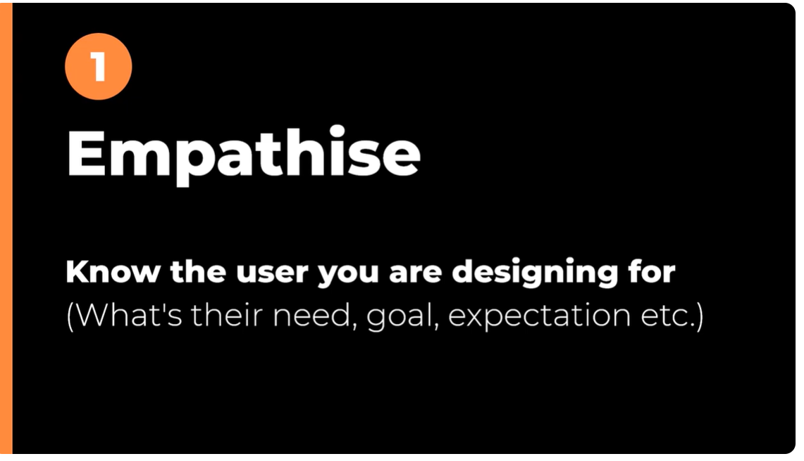

Slide 10
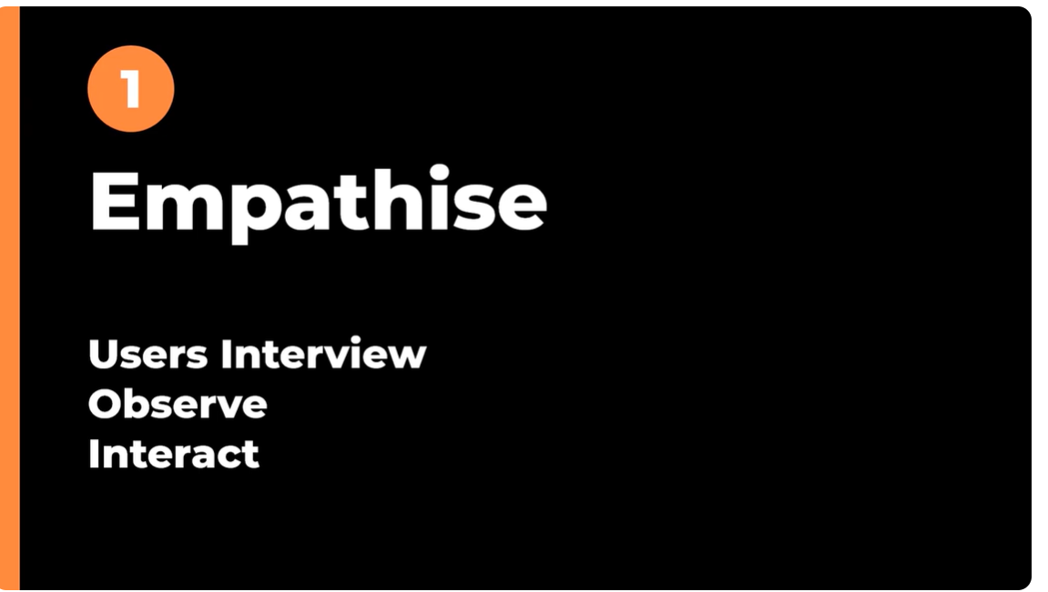

Slide 11
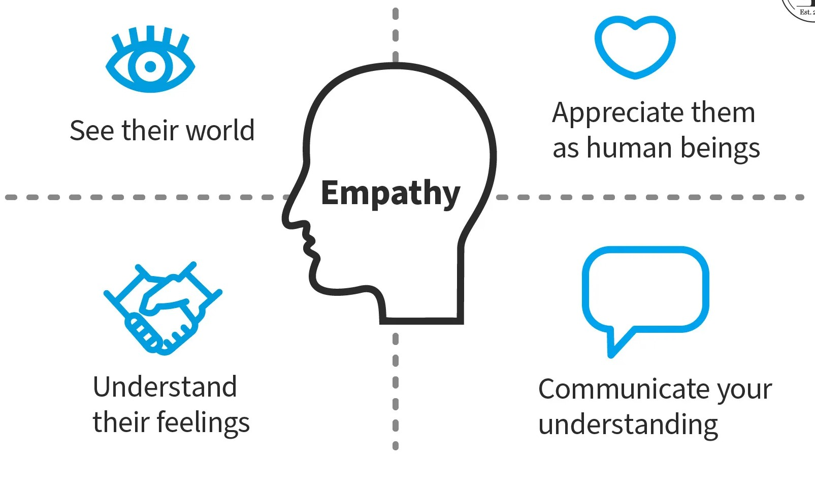

Slide 12
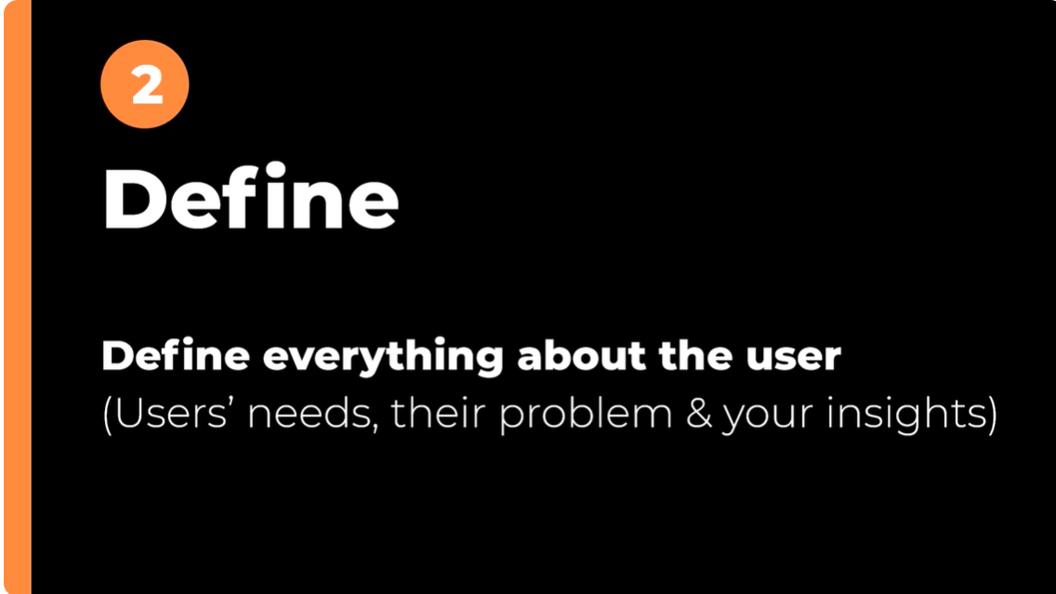

Slide 13
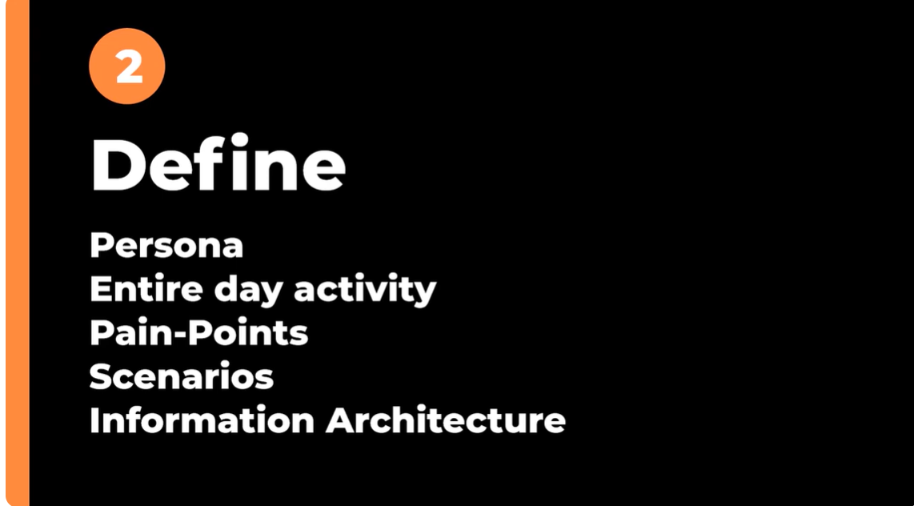

Slide 14
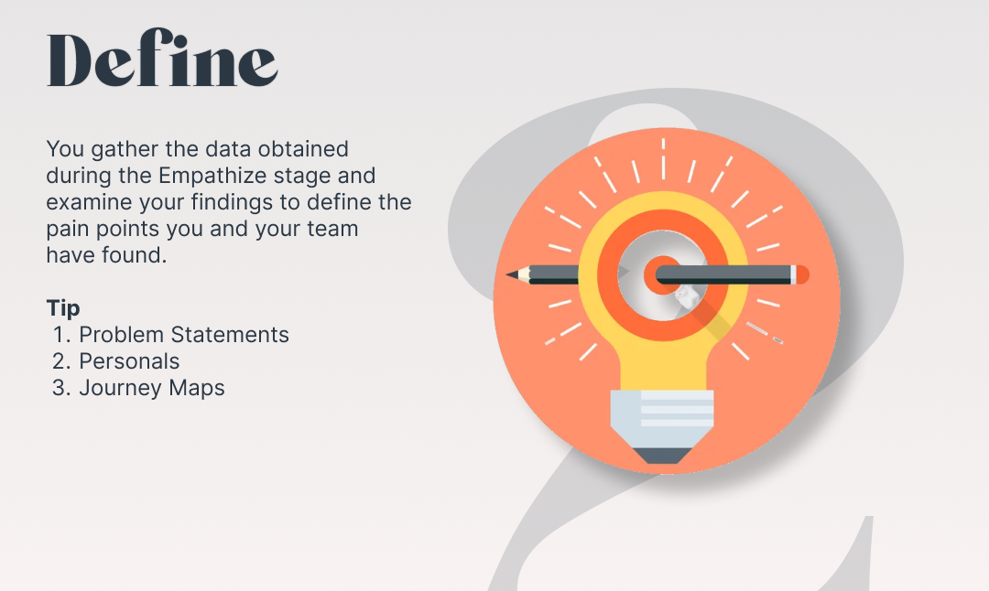

Slide 15
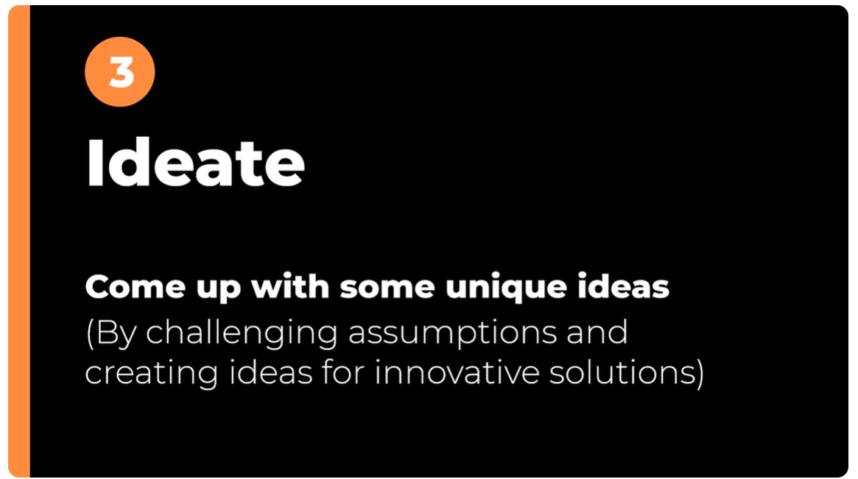

Slide 16


Slide 17
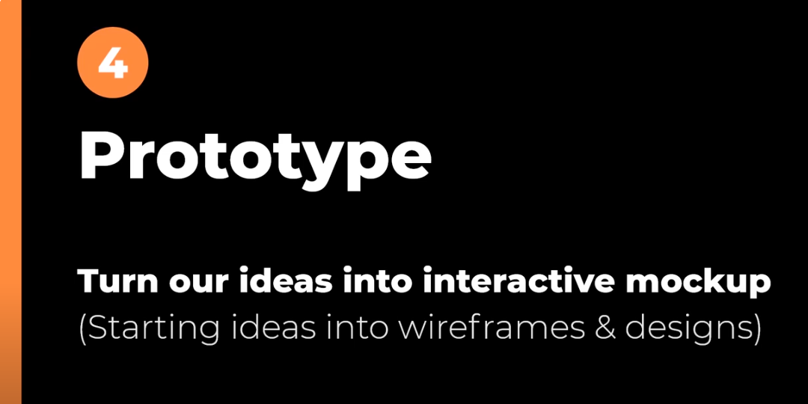

Slide 18
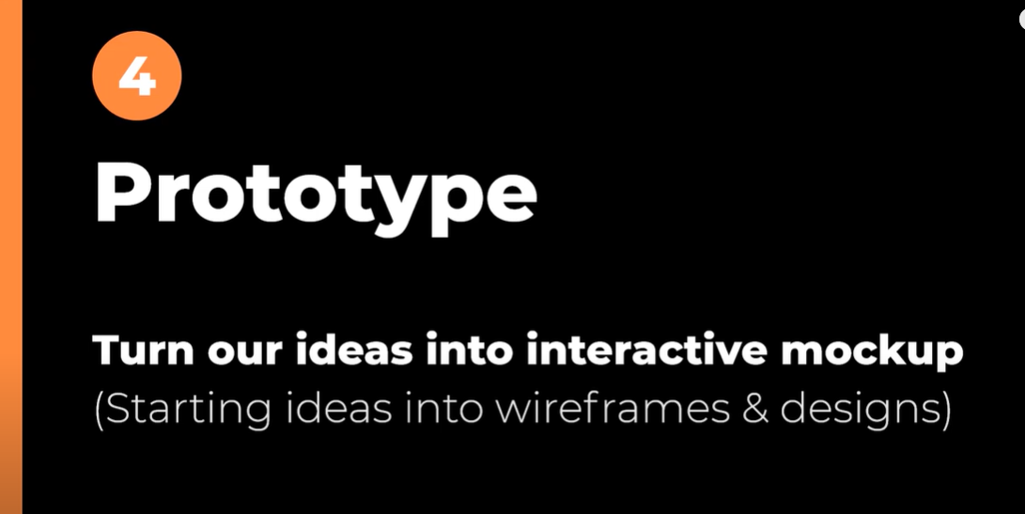

Slide 19
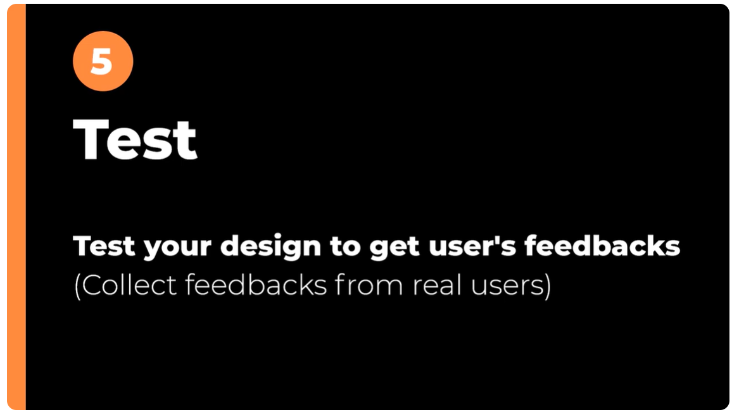

Slide 20


